Slide 1
Dash Period
By
Shristi Hingle
Avineshwar Pratap Singh
Vinod Tiwari

Slide 2

The App – Dash Period
Dash Period stores your menstrual cycle information simply by clicking a dash button
Shows nearby pharmacies
Calendar View
App Icon

Slide 3
Overview
Server Node
APNS
Dash button
App

Slide 4
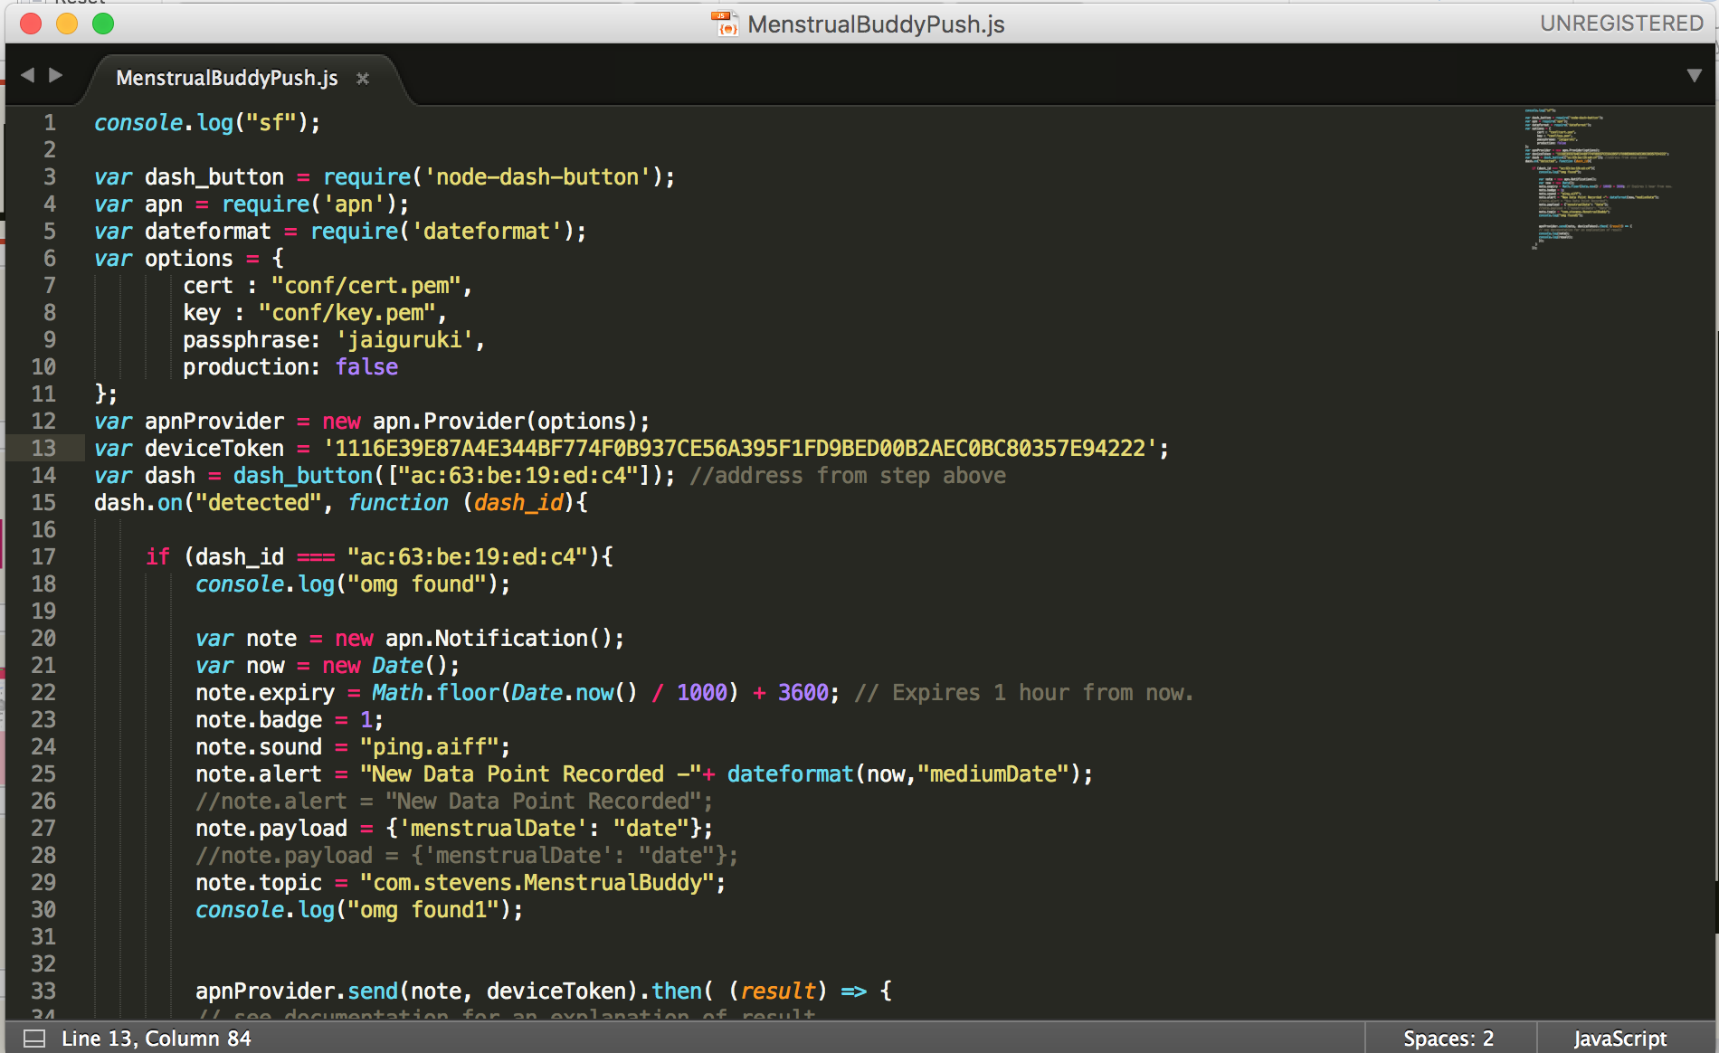
Node Server

Slide 5
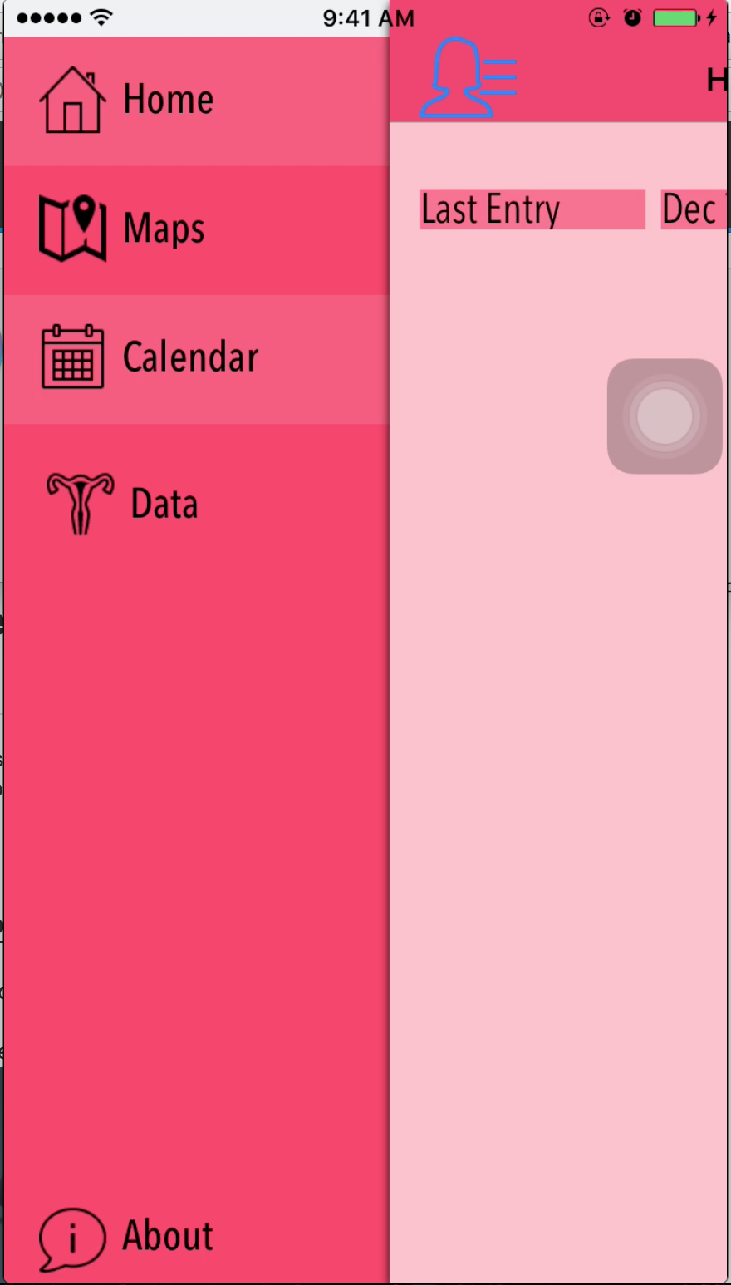
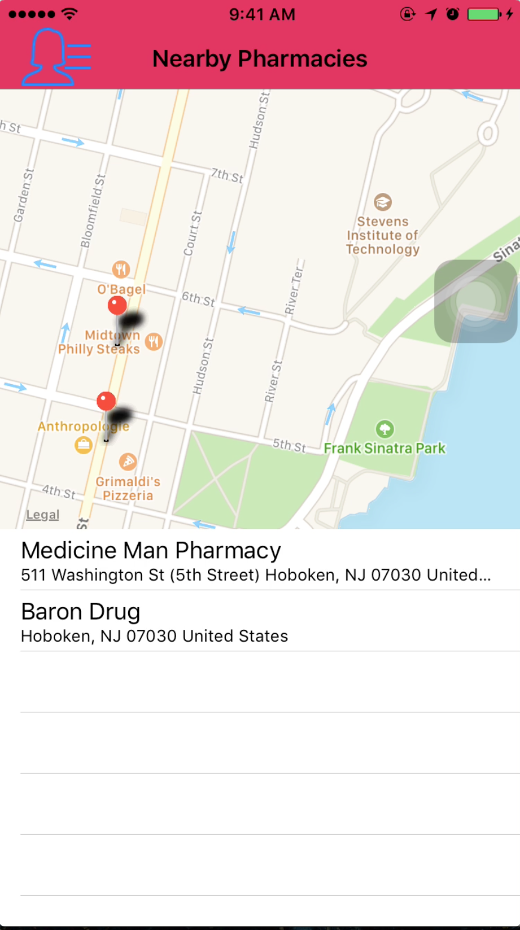
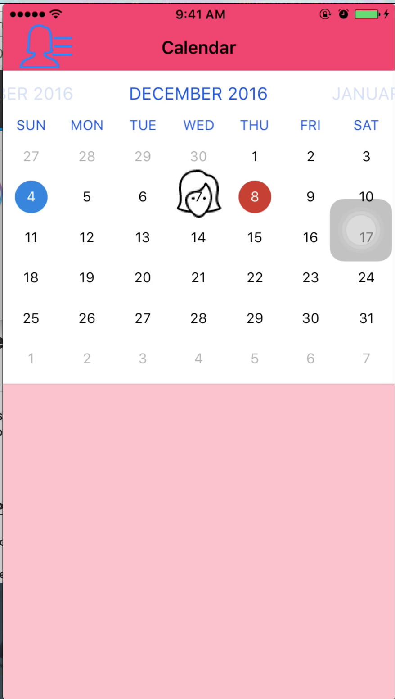
Overview

Slide 6
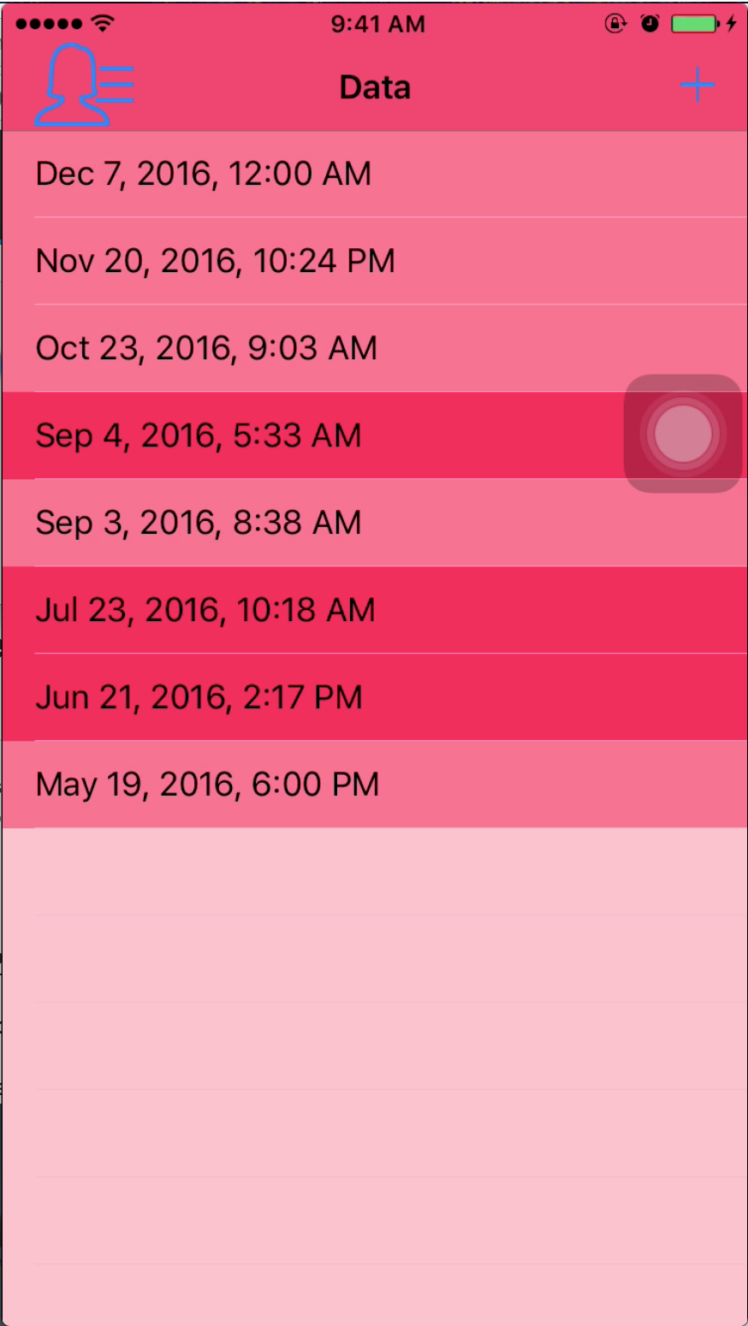
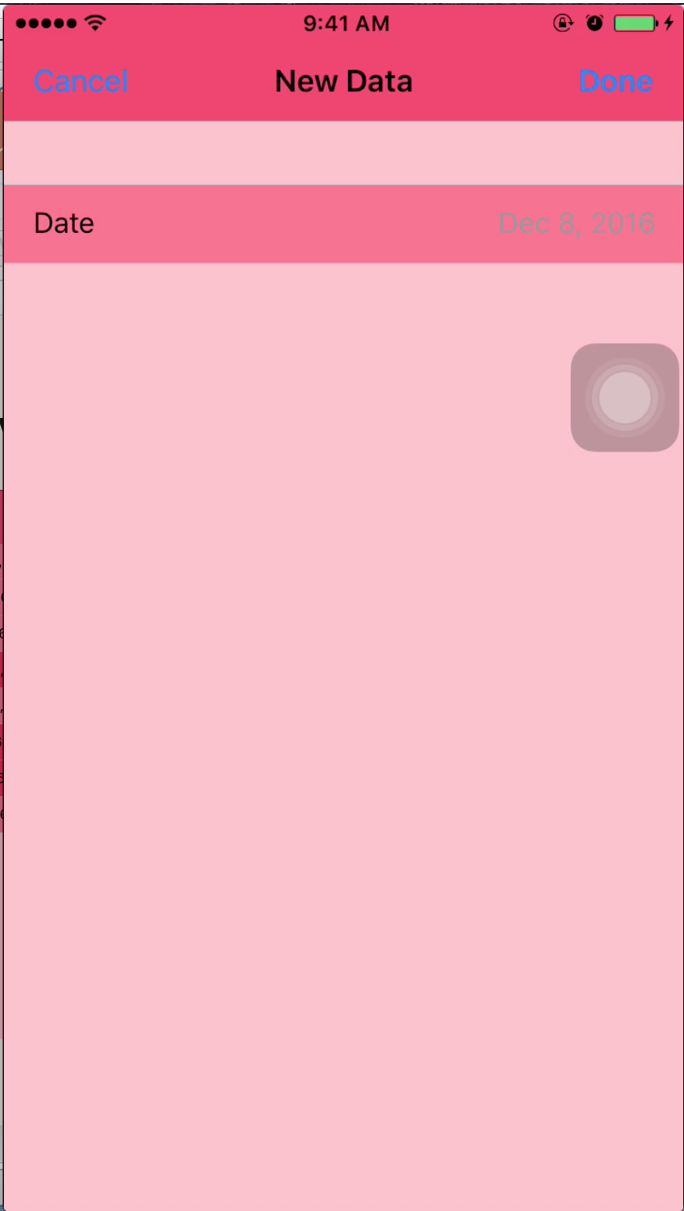
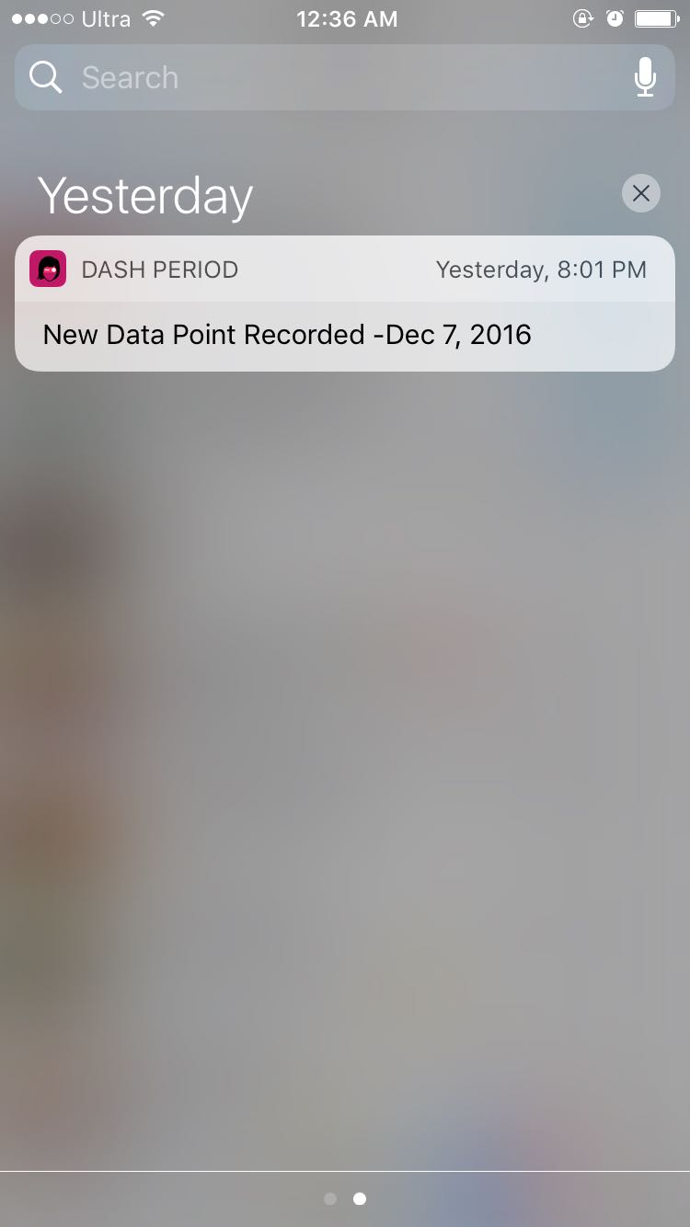
Overview

Slide 7
Frameworks
MapKit, Quadrat and RealmSwift – Pharmacy Locator
FSCalendar – Calendar Feature
HealthKit
Future Scope
Local Notifications to alert user before start of cycle
Edit Delete existing data from app

